Slide 1
DESN2000 MECH Workshop
Week 3 – Axiomatic Design and Fasteners
Notes:
This class may take more time, so all good if you need to use the full 2 hours.

Slide 2
Class overview
Design Parameters
(10 min)
Axiomatic Design
( 20 min)
Fasteners
(30 min)
Project Time!
(50 min)
Summary
(5 min)

Slide 3
Design Parameters
Design Parameters | Axiomatic Design | Fasteners | Project Time! | Summary
10 min | 20 min | 30 min | 65 min | 5 min
All | All | All | Groups | All

Slide 4
Design Parameters – Recall
Design parameters
How to fulfil functional requirements
Functional requirements
How to achieve customer needs
Notes:
This is a quick recall slide to differentiate FRs and DPs

Slide 5
Design Parameters – Recall
Train
Bus
Uber/Taxi
Bicycle
Walk
Motorcycle
Tip: To help in creating a diverse range of concepts, try to come up with multiple potential DPs for each individual FR you create.
FR: Commute to Uni
Note: When you create each concept however, you should only map one DP to each FR.
Notes:
This is to show how many different design parameters could fulfil the same FR. It is just to clarify at what point in the process they can be broad and where they should be more constrained.

Slide 6
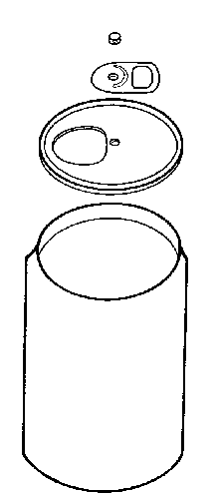
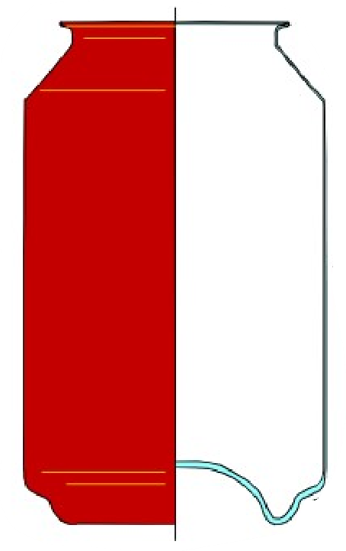
Design Parameters – Recall
Also…
Design Parameters don’t always have to be different types of physical components!
Example: Aluminium soda can
FR | DP
Withstand axial pressure | Curvature of base of can
Withstand radial pressure | Thickness of wall material
Sometimes they can be physical dimensions or other numerical parameters.
Notes:
This was quite a discovery for me after reading the section from the axiomatic design textbook on design parameters. It makes sense when you consider the word “parameter” in the mathematical context. A DP does not have to always be a physical component (gears, belts, chains etc.) a geometrical dimensions (drag coefficient, material thickness, volume of container etc.) can all be design parameters.

Slide 7
Axiomatic Design: Independence Axiom
Design Parameters | Axiomatic Design | Fasteners | Project Time! | Summary
10 min | 20 min | 30 min | 65 min | 5 min
All | All | All | Groups | All

Slide 8

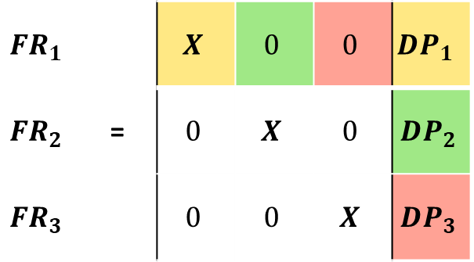
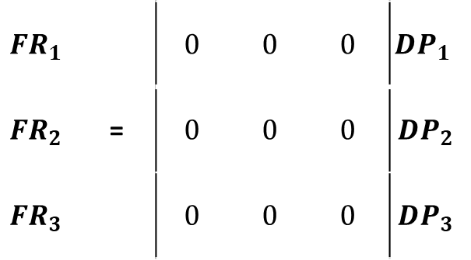
Independence Axiom
“Each Functional Requirement should be satisfied by only one Design Parameter.”
$$FR_{1}$$ |  | $$0$$ | $$0$$ | $$0$$ | $$DP_{1}$$
$$FR_{2}$$ | = | $$0$$ | $$0$$ | $$0$$ | $$DP_{2}$$
$$FR_{3}$$ |  | $$0$$ | $$0$$ | $$0$$ | $$DP_{3}$$
Main goal: To evaluate and simplify your design concepts, by minimising the number of coupled FRs.
How to determine:
Create Independence Axiom matrix
FR left side, DP right side
$X$ if DP fulfils a given FR across a row, $0$ for if DP does not fulfil FR.
$$FR_{1}$$ |  | $$X$$ | $$0$$ | $$0$$ | $$DP_{1}$$
$$FR_{2}$$ | = | $$0$$ | $$X$$ | $$0$$ | $$DP_{2}$$
$$FR_{3}$$ |  | $$0$$ | $$0$$ | $$X$$ | $$DP_{3}$$
Notes:
A quick summary on how to fill out an independence matrix.

Slide 9
Independence Axiom
How to evaluate your matrices
Uncoupled Concepts
(always best)
Independent of orders
of decisions
Decoupled Concepts
(acceptable)
Specific decision orders
must be maintained
Coupled Concepts
(always bad)
Impossible to manage
decision orders
Notes:
This is just taken from the lecture slides to help reinforce the types of designs that can occur.

Slide 10
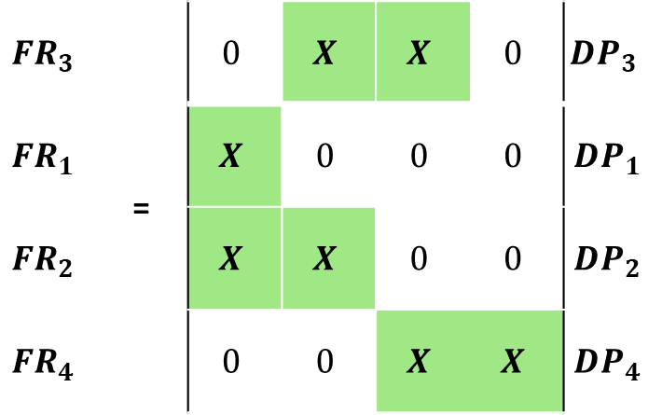
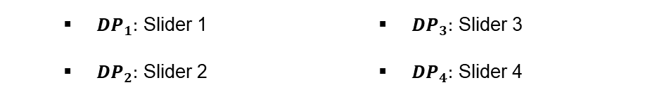
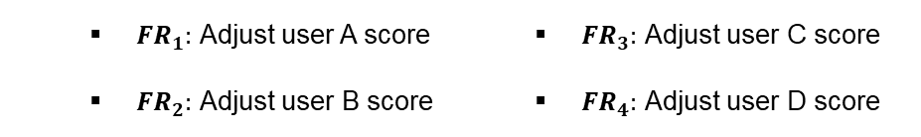
Independence Axiom
A coupled matrix is fixable! (sometimes)
User A
User B
User C
User D
$$FR_{3}$$ | = | $$0$$ | $$X$$ | $$X$$ | $$0$$ | $$DP_{3}$$
$$FR_{1}$$ | = | $$X$$ | $$0$$ | $$0$$ | $$0$$ | $$DP_{1}$$
$$FR_{2}$$ |  | $$X$$ | $$X$$ | $$0$$ | $$0$$ | $$DP_{2}$$
$$FR_{4}$$ |  | $$0$$ | $$0$$ | $$X$$ | $$X$$ | $$DP_{4}$$
FRs for peer evaluation tool
$FR_{1}:$ Adjust user A score
$FR_{2}:$ Adjust user B score
$FR_{3}:$ Adjust user C score
$FR_{4}:$ Adjust user D score
DPs for peer evaluation tool
${DP}_{1}:$ Slider 1
$DP_{2}:$ Slider 2
$DP_{3}:$ Slider 3
$DP_{4}:$ Slider 4
There is coupling present! What could we do to fix it?
Notes:
This is an example which Oliver used in his slides last year and after discussion, I decided to use it over my one that was taken from the axiomatic design textbook. Recall that the peer evaluation tool comprises of a bar chart where the percentage contribution of each member is adjusted with sliders. Recall also that, moving one slider causes the percentage of the adjacent users to move. In reality there’s not slider for user D on the very end, but for the sake of preserving a square matrix consistent to the lecture slides, we will have a 4th slider. Slider 1 to 4 are counted from left to right.
Yes we logically would work the sliders from left to right, but an ideal design should enable the tool to work regardless of order. Thus, this is why we enter the example from the hypothetical scenario of someone trying to move the sliders in a random manner. The point to communicate is that, if they move the sliders randomly, each slider affects the input of the others (Moving slider 3 affects C and D’s score), but moving slider 2 after would affect C’s score also, in addition to slider B. Moving slider 1 then would affect B’s score again, and so on.
Ask the students what could be done to resolve this issue before moving on

Slide 11
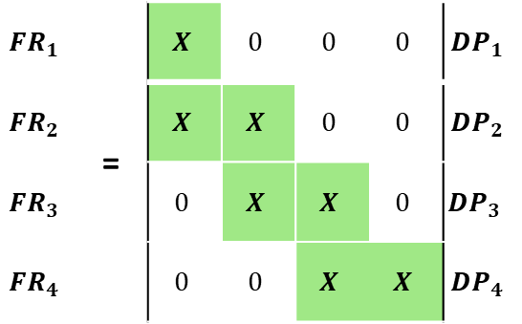
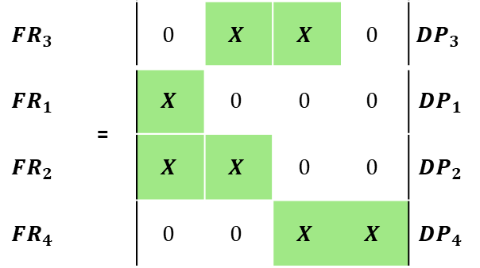
Independence Axiom
A coupled matrix is fixable! (sometimes)
$$FR_{3}$$ | = | $$0$$ | $$X$$ | $$X$$ | $$0$$ | $$DP_{3}$$
$$FR_{1}$$ | = | $$X$$ | $$0$$ | $$0$$ | $$0$$ | $$DP_{1}$$
$$FR_{2}$$ |  | $$X$$ | $$X$$ | $$0$$ | $$0$$ | $$DP_{2}$$
$$FR_{4}$$ |  | $$0$$ | $$0$$ | $$X$$ | $$X$$ | $$DP_{4}$$
User A
User B
User C
User D
We can reduce the effect of coupling by introducing order. By adjusting the sliders from left to right (1 to 4), then the results of the users further down the track are not affected by the sliders that we are using at any one point.
$$FR_{1}$$ | = | $$X$$ | $$0$$ | $$0$$ | $$0$$ | $$DP_{1}$$
$$FR_{2}$$ |  | $$X$$ | $$X$$ | $$0$$ | $$0$$ | $$DP_{2}$$
$$FR_{3}$$ |  | $$0$$ | $$X$$ | $$X$$ | $$0$$ | $$DP_{3}$$
$$FR_{4}$$ |  | $$0$$ | $$0$$ | $$X$$ | $$X$$ | $$DP_{4}$$
Keep in mind that not every matrix can be fixed by order. Sometimes there is too much coupling, and you may need to remove the influence certain design parameters have to functional requirements (i.e., reduce the number of FR a given DP fulfils) to fix the coupling issue.
Notes:
Provide reassurance to students that if they don’t understand it right now it is not a big issue as this is not expected for the interim presentation. If they have question, they can ask us demonstrators and we can try to help them on a case-by-case basis. Axiomatic design is actually really complicated. It attempts to combine mathematical analysis (think back to matrices in math 1A and 1B) to design.

Slide 12
Fasteners
Design Parameters | Axiomatic Design | Fasteners | Project Time! | Summary
10 min | 20 min | 30 min | 65 min | 5 min
All | All | All | Groups | All

Slide 13
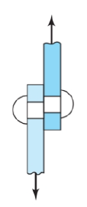
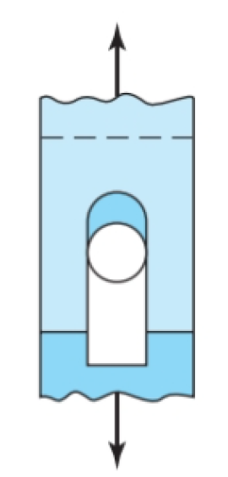
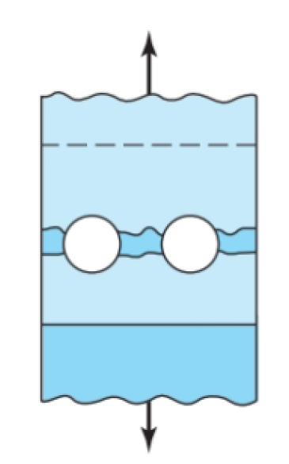
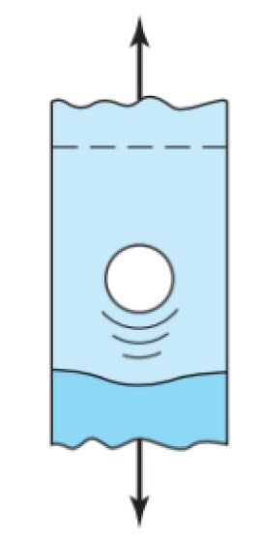
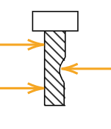
Fasteners
How much do you need to know and how does it apply to assessments?
In your final report, you can choose to perform a technical analysis of the fasteners you use on an aspect of your device. One way to do this is to analyse the loading cases your fasteners will experience in your final design concept and predict the failure mode which they might experience. You can then use this to then justify your choice of fasteners, how many and where they are placed.
Bolt shear failure
Bolt bearing failure
Bearing failure of members
Edge shearing of members
Tensile failure of members
Notes:
This is an overview of how the content ties into their assignments and how they can do it. Remind students that this is one of 4 areas that they can pick to analyse. They will need to pick 2 out of 4, but reassure students that if they don’t want to choose this area for their final report, they don’t have to. Of course, they can also opt to build the prototype and not do the analysis at all.
The list of failure modes are examples of the most common (and what the example explores from Shigley’s textbook). There are more cases than this.

Slide 14
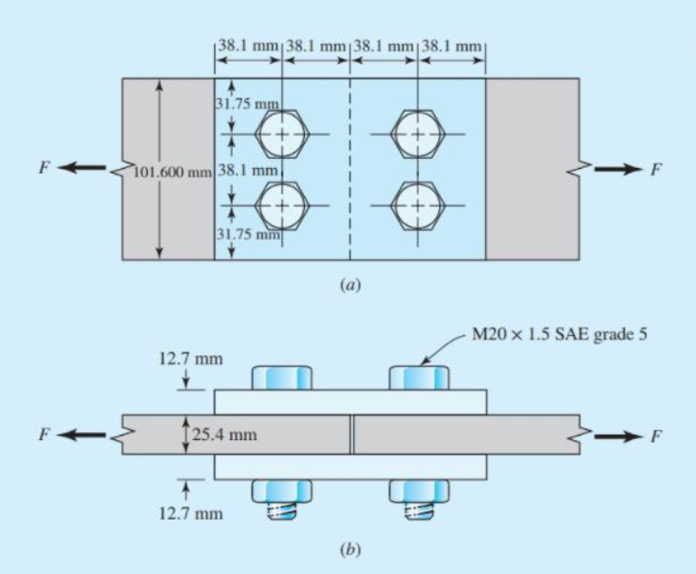
Fasteners – example
Goal: Determine the maximum load which can be carried.
Method: Evaluate the joint for all failure modes and find the mode which requires the lowest force.
Notes:
A breakdown of the problem and what needs to be determined.

Slide 15
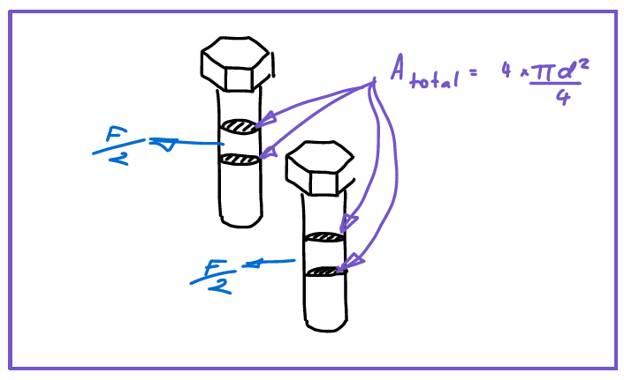
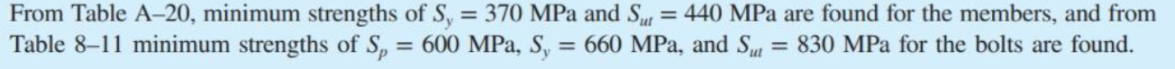
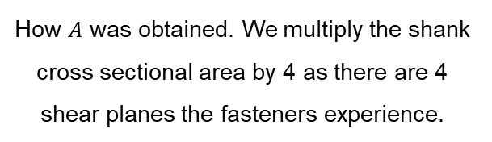
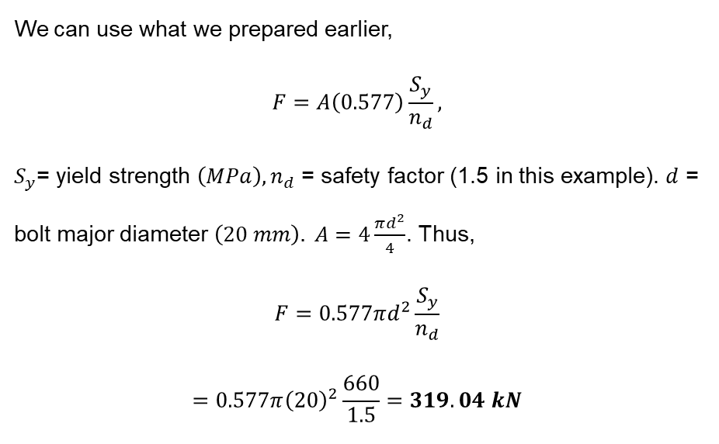
Scenario 1 – Bolt shear failure
We can use what we prepared earlier,
$$F=A\left(0.577\right)\frac{S_{y}}{n_{d}},$$
$S_{y}$= yield strength $\left(MPa\right), n_{d}$ = safety factor (1.5 in this example). $d$ = bolt major diameter $\left(20 mm\right). A=4\frac{πd^{2}}{4}$. Thus,
$$F=0.577πd^{2}\frac{S_{y}}{n_{d}}$$
$$=0.577π{\left(20\right)}^{2}\frac{660}{1.5}=319.04 kN$$
How $A$ was obtained. We multiply the shank cross sectional area by 4 as there are 4 shear planes the fasteners experience.
Notes:
We choose to analyse for half the model due to symmetry and also that 2 bolts failing on one side is the most dangerous outcome (joint would fall apart). The material properties for the metal plates and bolt are given in the blue highlighted section.
Remind students that for their project, they can refer to material databases online and fastener catalogues for this information. The Shigley’s mechanical engineering design textbook (available in library) also provides some examples.

Slide 16
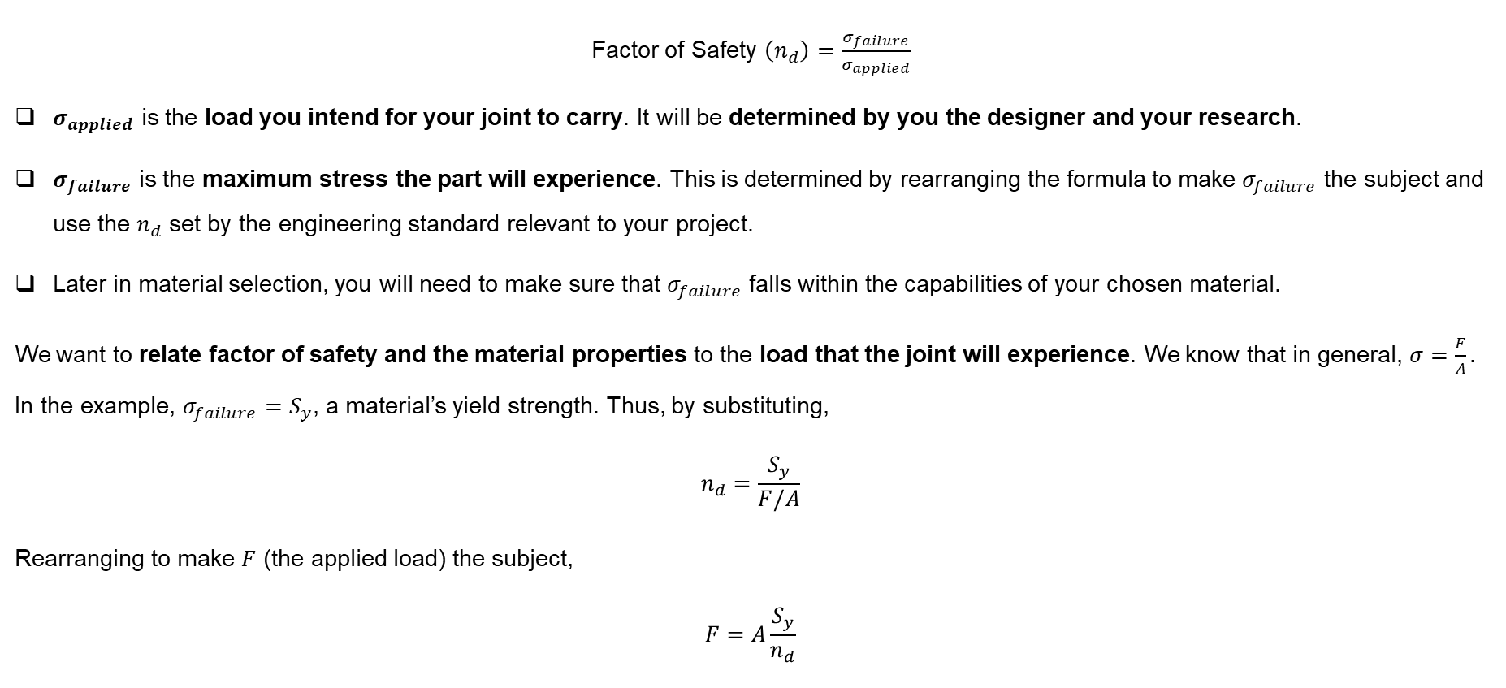
Before we start
The fundamental source of all equations you will use in this example, comes from your previous mechanical courses. For tensile stress,
Factor of Safety $\left(n_{d}\right)=\frac{σ_{failure}}{σ_{applied}}$
$σ_{applied}$ is the load you intend for your joint to carry. It will be determined by you the designer and your research.
$σ_{failure}$ is the maximum stress the part will experience. This is determined by rearranging the formula to make $σ_{failure}$ the subject and use the $n_{d}$ set by the engineering standard relevant to your project.
Later in material selection, you will need to make sure that $σ_{failure}$ falls within the capabilities of your chosen material.
We want to relate factor of safety and the material properties to the load that the joint will experience. We know that in general, $σ=\frac{F}{A}.$ In the example, $σ_{failure}=S_{y}$, a material’s yield strength. Thus, by substituting,
$$n_{d}=\frac{S_{y}}{F/A}$$
Rearranging to make $F$ (the applied load) the subject,
$$F=A\frac{S_{y}}{n_{d}}$$
We will use various versions of this in our analysis
Notes:
This and the following slide provide the foundations for all the equations they will use to perform the analysis. Essentially, the aim is to create an equation that links the applied load, the material’s innate properties and the factor of safety, which is often dictated by engineering standards, which students should use to design their joints and justify their fasteners.
This slide creates the equation using tensile stress, the next will do it for shear.

Slide 17

Before we start
You can use the same procedure to relate loading to material properties and factor of safety for shear stress. Just replace $σ$ with $τ.$
Factor of Safety $\left(n_{d}\right)=\frac{τ_{failure}}{τ_{applied}}$
We know that in general, $τ=\frac{F}{A}.$ Thus,
$$n_{d}=\frac{τ_{failure}}{F/A}$$
Rearranging to make $F$ the subject,
$$F=A\frac{τ_{failure}}{n_{d}}$$
However, most material data for fasteners and materials in general, are given in terms of tensile stress. However, there is an easy way to relate tensile and shear stress. The following relationship (Von Mises Criterion) can be used to approximately convert between the two.
$$τ=0.577σ$$
Since yield stress ${(S}_{y})$ in a materials data sheet is given in terms of tensile stress, we can re-write $F=A\frac{τ_{failure}}{n_{d}}$ as,
$$F=A\left(0.577\right)\frac{S_{y}}{n_{d}}$$
Notes:
This slide build the same base equation except for shear. You will essentially use either one of these depending on the failure mode in the following 5 slides.

Slide 18
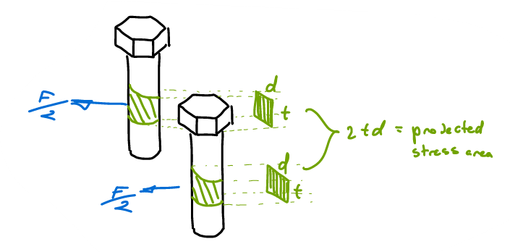
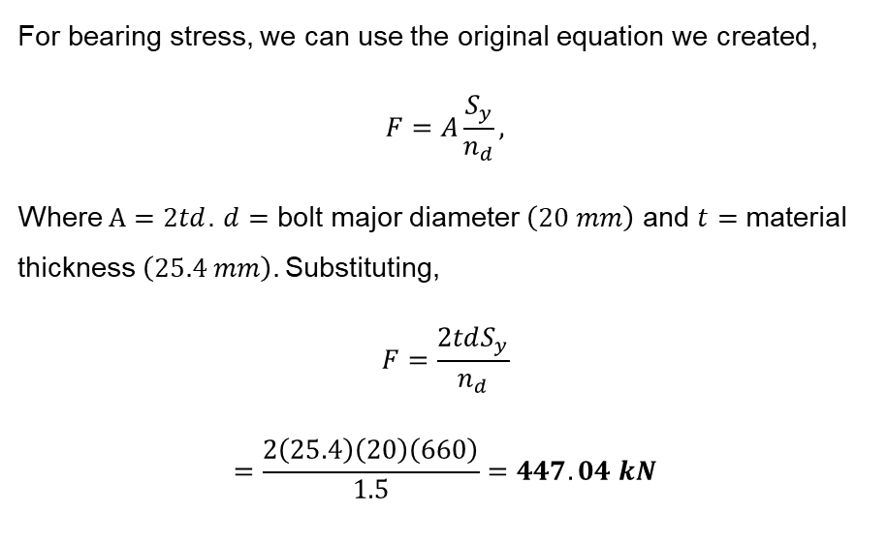
Scenario 2 – Bolt bearing failure
For bearing stress, we can use the original equation we created,
$$F=A\frac{S_{y}}{n_{d}},$$
Where $A=2td$. $d=$ bolt major diameter $\left(20 mm\right)$ and $t=$ material thickness $\left(25.4 mm\right).$Substituting,
$$F=\frac{2tdS_{y}}{n_{d}}$$
$$=\frac{2\left(25.4\right)\left(20\right)\left(660\right)}{1.5}=447.04 kN$$
How $d$ and $t$ were obtained.
Notes:
Here we analyse bearing failure for the middle plate only as opposed to also for the two thinner outer plates in slide 13. This is because in this particular example, the same force is exerted from both sides and the outer splicing plates are equal in thickness, and when summed up, equal to the thickness of the middle plate. They are also all made of the same metal, and thus have the same yield strength. Thus, analysing either of them would lead to the same answer. If students are analysing a joint where different materials or materials of asymmetrical thickness are used, then they should perform the analysis for each member in the joint.

Slide 19
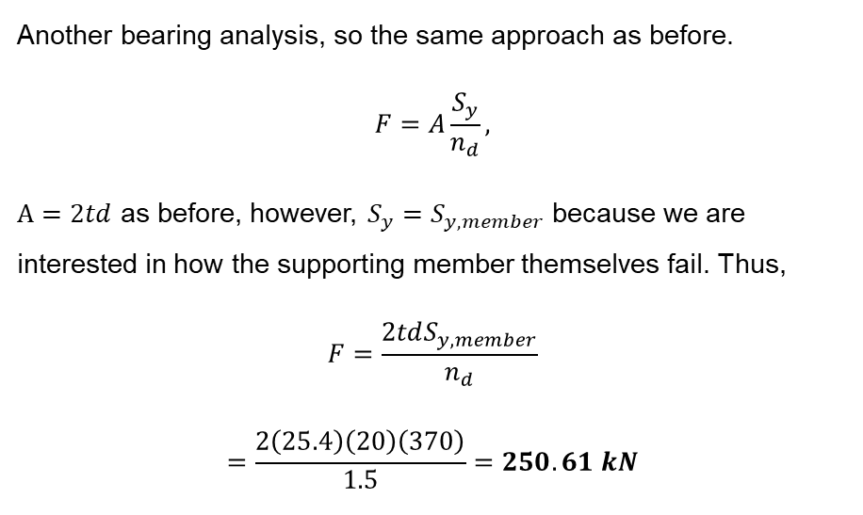
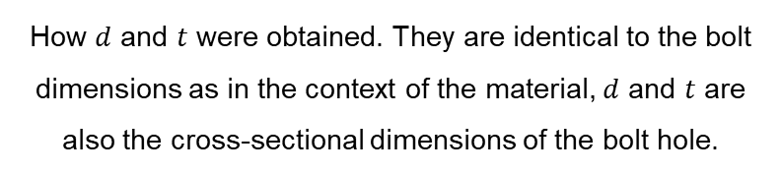
Scenario 3 – Bearing failure of members
Another bearing analysis, so the same approach as before.
$$F=A\frac{S_{y}}{n_{d}},$$
$A=2td$ as before, however, $S_{y}=S_{y,member}$ because we are interested in how the supporting member themselves fail. Thus,
$$F=\frac{2tdS_{y,member}}{n_{d}}$$
$$=\frac{2\left(25.4\right)\left(20\right)\left(370\right)}{1.5}=250.61 kN$$
How $d$ and $t$ were obtained. They are identical to the bolt dimensions as in the context of the material, $d$ and $t$ are also the cross-sectional dimensions of the bolt hole.
Notes:
The note mentioned in the previous slide applies for this and all the scenarios in this workshop. The guess is that the textbook used this highly symmetrical case so that the explanation can be more simplified.

Slide 20
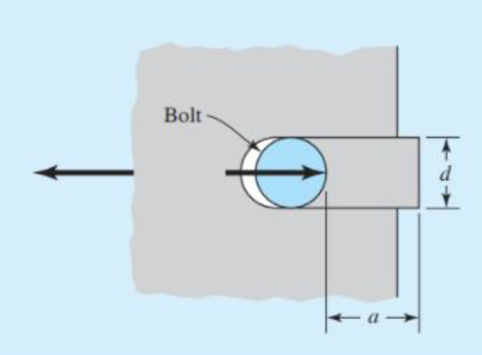
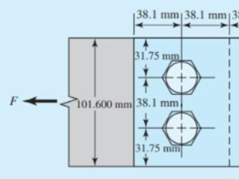
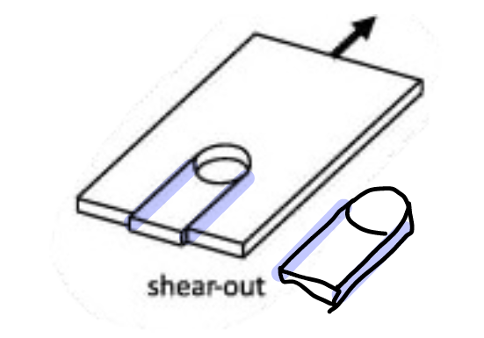
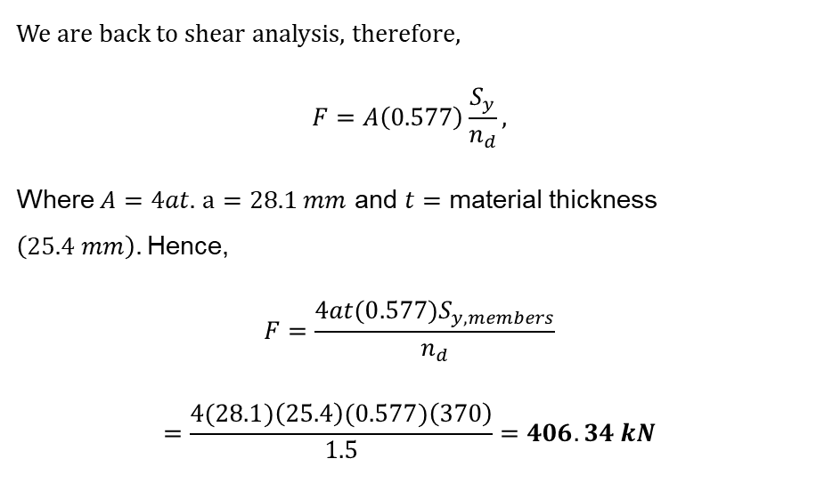
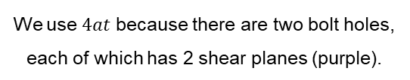
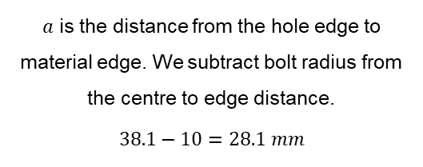
Scenario 4 – Edge shearing of members
We are back to shear analysis, therefore,
$$F=A\left(0.577\right)\frac{S_{y}}{n_{d}},$$
Where $A=4at.$ $a=28.1 mm$ and $t=$ material thickness $\left(25.4 mm\right).$Hence,
$$F=\frac{4at(0.577)S_{y,members}}{n_{d}}$$
$$=\frac{4(28.1)\left(25.4\right)(0.577)\left(370\right)}{1.5}=406.34 kN$$
$a$ is the distance from the hole edge to material edge. We subtract bolt radius from the centre to edge distance.
$$38.1−10=28.1 mm$$
We use $4at$ because there are two bolt holes, each of which has 2 shear planes (purple).
Notes:
The diagram in the bottom right is helpful for students if they are confused about what part of the member is being sheared. Aside from the previously mentioned reasons, the middle plate is being analysed here because it is also the most critical failure scenario. Failure of one of the outer 2 splice plates would be somewhat acceptable as there is a second plate holding the joint together. Failure of the middle plate means that the joint will fall apart. Designing conservatively and for the most critical cases is a centrally used idea in engineering, as this ensures that structures are always slightly overdesigned to account for extraordinary loading/use case scenarios.

Slide 21
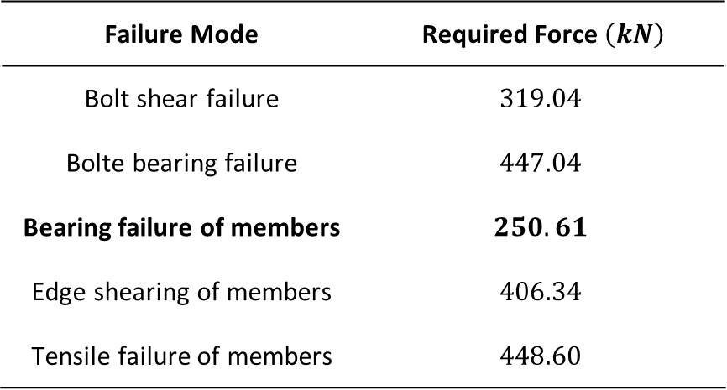

Determining final answer
Compare the required force for failure and identify the one with the lowest magnitude.
Failure Mode | Required Force $\left(kN\right)$
Bolt shear failure | $$319.04$$
Bolt bearing failure | $$447.04$$
Bearing failure of members | $$250.61$$
Edge shearing of members | $$406.34$$
Tensile failure of members | $$448.60$$
Thus, in this case we see that the limiting failure mode is bearing failure of members, which occurs at $250.61 kN$.
Final answer: the maximum load which can be carried is $250.61 kN$, beyond which failure by bearing failure of members will occur.
Tip: You can instead make another parameter such as $S_{y}$ or other geometric variables if you know the load that the joint must carry the subject. This will allow you to calculate the minimum yield strength, thickness, bolt size, etc. you need for your joint to work.
Notes:
The final tip is another reminder to students that this is one method they can use in the technical analysis. Perhaps they already know the applied load and want to figure out what sized bolt they need. Then, they can rearrange the equations used to make for example, the bolt diameter the unknown subject, and solve for that to find out the minimum bolt size they need in order to support the load their design will experience.

Slide 22
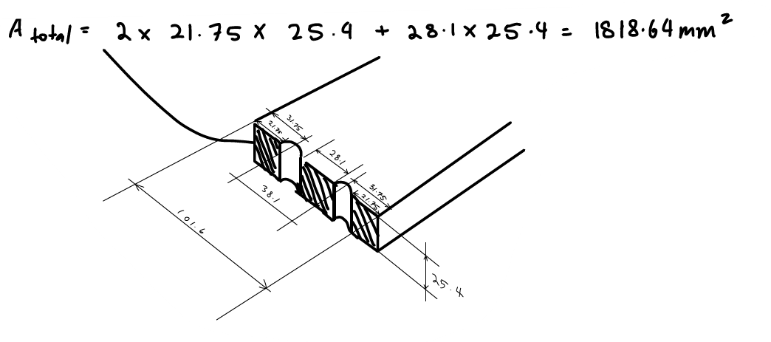

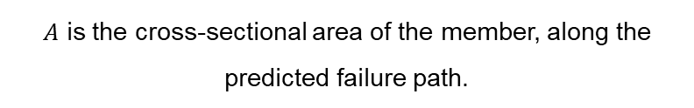
Scenario 5 – Tensile failure of members
Same as the other tensile cases,
$$F=A\frac{S_{y}}{n_{d}},$$
Where $A=1818.64 mm^{2},$ and $S_{y}=S_{y,member}$. Thus,
$$F=A\frac{S_{y,members}}{n_{d}}$$
$$=1818.64\frac{370}{1.5}=448.60 kN$$
$A$ is the cross-sectional area of the member, along the predicted failure path.
Notes:
Numbers on for the cross sectional area is quite small. You may need to zoom in to see them better. It was the best I can do while preserving reasonable slide proportions.

Slide 23
Project Time!
Design Parameters | Axiomatic Design | Fasteners | Project Time! | Summary
10 min | 20 min | 30 min | 65 min | 5 min
All | All | All | Groups | All
Notes:
Remainder of the class time as usual, is for students to work on their projects and for demonstrators to assist where needed.

Slide 24
Summary
Design Parameters | Axiomatic Design | Fasteners | Project Time! | Summary
10 min | 20 min | 30 min | 65 min | 5 min
All | All | All | Groups | All

Slide 25
Summary
Today we covered:
Axiomatic design methods
Fasteners
Assignment reminders
Presentation slides due date: Sunday Week 3
Presentation day: during MECH workshop in Week 4
Next week:
Presentations!
Planning User testing

